Slide 1
Computer graphics
Polygon Filling
Thanks to
Dr. Eng. Farag Elnagahy
farahelnagahy@hotmail.com
Office Phone: 67967

Slide 2
Polygon Filling
Types of filling
Solid-fill
All the pixels inside the polygon’s boundary are illuminated.
Pattern-fill
the polygon is filled with an arbitrary predefined pattern.

Slide 3
Polygon Representation
The polygon can be represented by listing its n vertices in an ordered list.
P = {(x₁, y₁), (x₂, y₂), ……., (x_{n}, y_{n})}.
The polygon can be displayed by drawing a line between (x₁, y₁), and (x₂, y₂), then a line between (x₂, y₂), and (x₃, y₃), and so on until the end vertex. In order to close up the polygon, a line between (x_{n}, y_{n}), and (x₁, y₁) must be drawn.
One problem with this representation is that if we wish to translate the polygon, it is necessary to apply the translation transformation to each vertex in order to obtain the translated polygon.

Slide 4
Polygon Representation
For objects described by many polygons with many vertices, this can be a time consuming process.
One method for reducing the computational time is to represent the polygon by the (absolute) location of its first vertex, and represent subsequent vertices as relative positions from the previous vertex. This enables us to translate the polygon simply by changing the coordinates of the first vertex.

Slide 5
Inside-Outside Tests
when filling polygons we should decide whether a particular point is interior or exterior to a polygon.
A rule called the odd-parity (or the odd-even rule) is applied to test whether a point is interior or not.
To apply this rule, we conceptually draw a line starting from the particular point and extending to a distance point outside the coordinate extends of the object in any direction such that no polygon vertex intersects with the line.

Slide 6
Inside-Outside Tests
The point is considered to be interior if the number of intersections between the line and the polygon edges is odd. Otherwise, The point is exterior point.
Outside
8
7
6
5
4
3
2
1
0
0
1
2
3
4
5
6
7
8
9
10
11
Inside

Slide 7
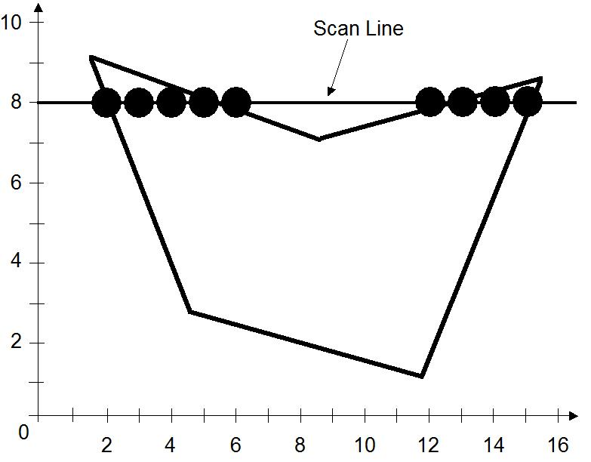
The Scan-Line Polygon Fill Algorithm
https://www.youtube.com/watch?v=rJJSB53Ut1I
The scan-line polygon-filling algorithm involves
the horizontal scanning of the polygon from its lowermost to its topmost vertex,
identifying which edges intersect the scan-line,
and finally drawing the interior horizontal lines with the specified fill color. process.

Slide 8
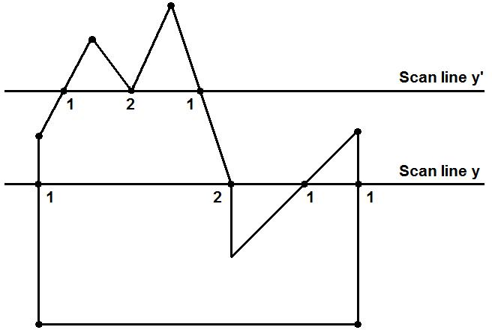
The Scan-Line Polygon Fill Algorithm
Dealing with vertices

Slide 9
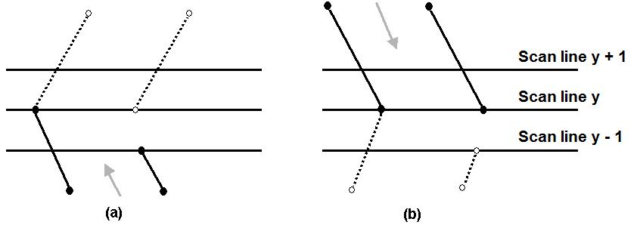
The Scan-Line Polygon Fill Algorithm
Dealing with vertices
When the endpoint y coordinates of the two edges are increasing, the y value of the upper endpoint for the current edge is decreased by one (a)
When the endpoint y values are decreasing, the y value of the next edge is decreased by one (b)

Slide 10
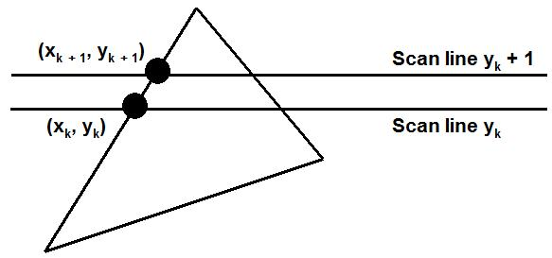
The Scan-Line Polygon Fill Algorithm
Determining Edge Intersections
m = (y_{k+1} – y_{k}) / (x_{k+1} – x_{k})
y_{k+1} – y_{k} = 1
x_{k+1} = x_{k} + 1/m

Slide 11
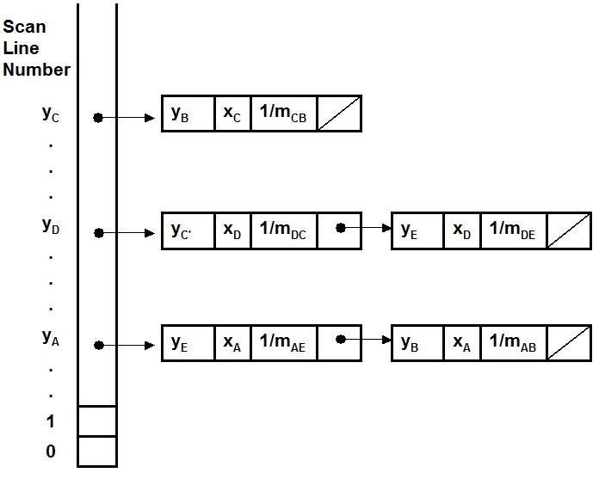
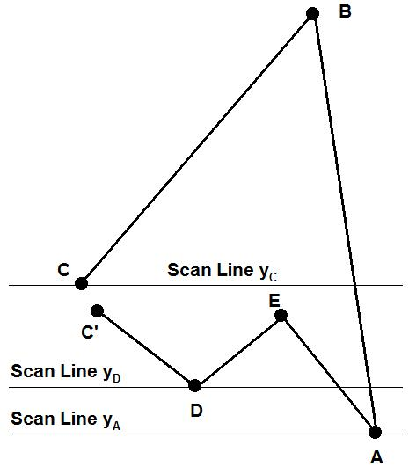
The Scan-Line Polygon Fill Algorithm
Each entry in the table for a particular scan line contains the maximum y value for that edge, the x-intercept value (at the lower vertex) for the edge, and the inverse slope of the edge.

Slide 12
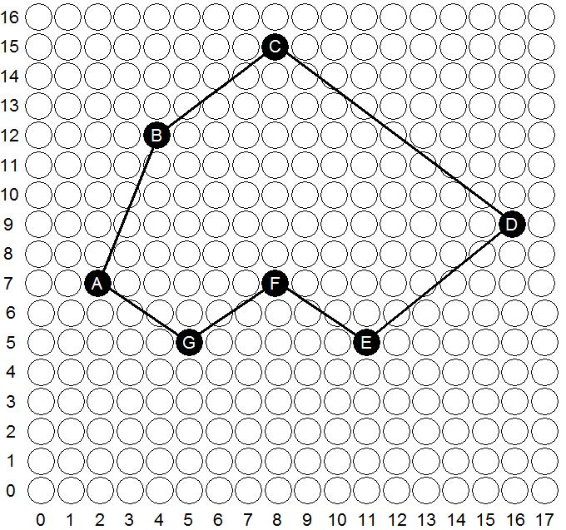
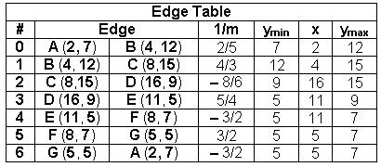
The Scan-Line Polygon Fill Algorithm
(Example) Polygon = {A, B, C, D, E, F, G}
Polygon = {(2, 7), (4, 12), (8,15), (16, 9), (11, 5), (8, 7), (5, 5)}

Slide 13
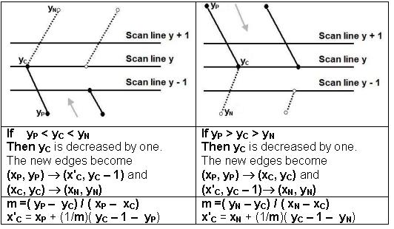
The Scan-Line Polygon Fill Algorithm
(Example)

Slide 14
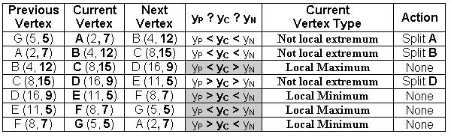
The Scan-Line Polygon Fill Algorithm
(Example)
Vertex A should be split into two vertices A' (x_{A'}, 6) and A(2, 7)
m =( 5 – 7)/( 5 – 2) = – 2/3
x'_{A} = 5 + (–3/2)( 7 – 1 – 5) = 7/2 = 3.5 ≅ 4
The vertex A is split to A' (4, 6) and A(2, 7)

Slide 15
The Scan-Line Polygon Fill Algorithm
(Example)
Vertex B should be split into two vertices B' (x_{B'}, 11) and B(4, 12)
m =( 7 – 12)/( 2 – 4) = 5/2
x'_{A} = 2 + (2/5)( 12 – 1 – 7) = 18/5 = 3.6 ≅ 4
The vertex B is split to B' (4, 11) and B(4, 12)

Slide 16
The Scan-Line Polygon Fill Algorithm
(Example)
Vertex D should be split into two vertices D(16, 9) and D' (x_{D'}, 8)
m =( 5 – 9)/( 11 – 16) = 4/5
x'_{D} = 11 + (5/4)( 9 – 1 – 5) = 59/4 = 14.75 ≅ 15
The vertex D is split to D(16, 9) and D' (15, 8)

Slide 17
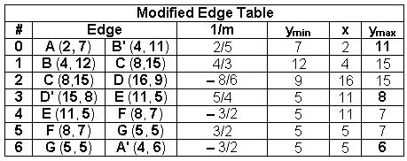

The Scan-Line Polygon Fill Algorithm
(Example)

Slide 18
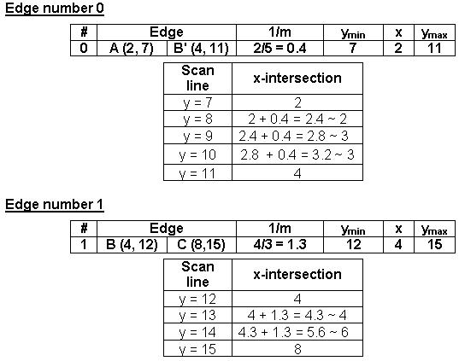
The Scan-Line Polygon Fill Algorithm
(Example)

Slide 19
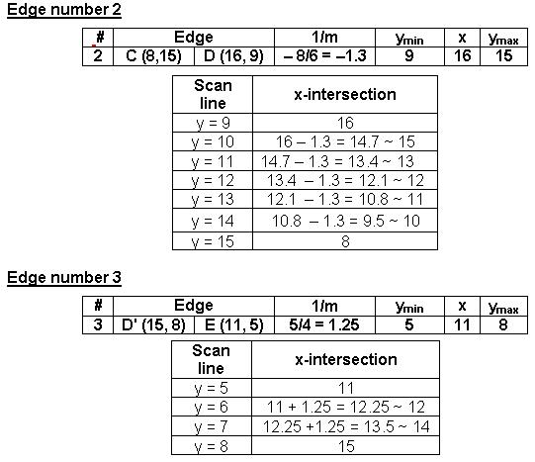
The Scan-Line Polygon Fill Algorithm
(Example)

Slide 20
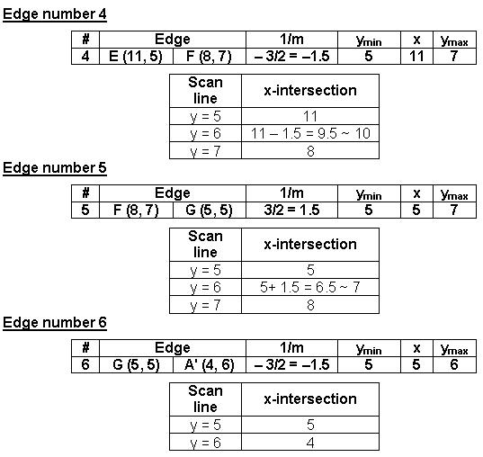
The Scan-Line Polygon Fill Algorithm
(Example)

Slide 21
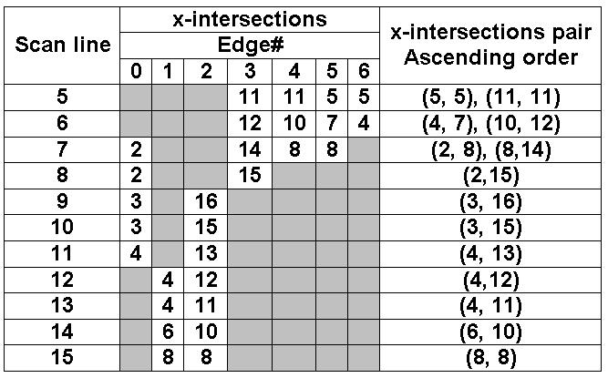
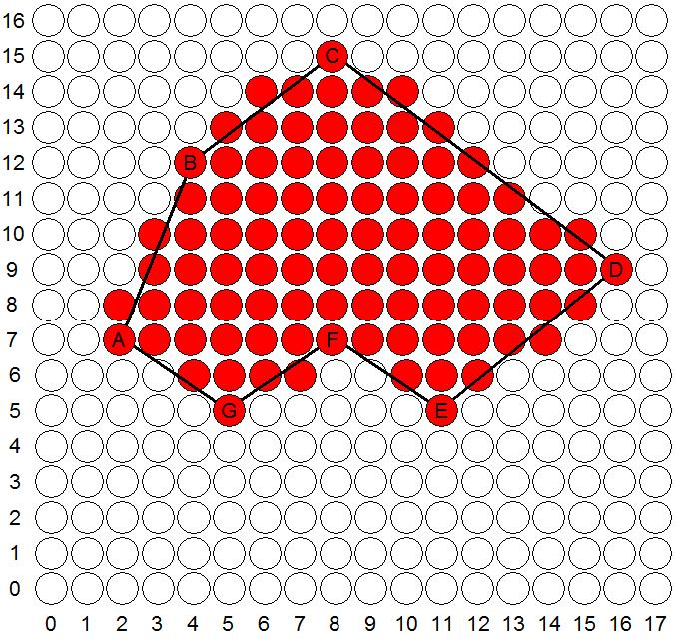
The Scan-Line Polygon Fill Algorithm
(Example)

Slide 22
Boundary Fill Algorithm
Another approach to area filling is to start at a point inside a region and paint the interior outward toward the boundary.
If the boundary is specified in a single color, the fill algorithm processed outward pixel by pixel until the boundary color is encountered.
A boundary-fill procedure accepts as input the coordinate of the interior point (x, y), a fill color, and a boundary color.

Slide 23
Boundary Fill Algorithm
The following steps illustrate the idea of the recursive boundary-fill algorithm:
1. Start from an interior point.
2. If the current pixel is not already filled and if it is not an edge point, then set the pixel with the fill color, and store its neighboring pixels (4 or 8-connected) in the stack for processing. Store only neighboring pixel that is not already filled and is not an edge point.
3. Select the next pixel from the stack, and continue with step 2.

Slide 24
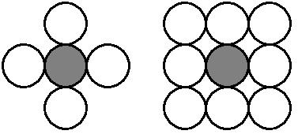
Boundary Fill Algorithm
The order of pixels that should be added to stack using 4-connected is above, below, left, and right. For 8-connected is above, below, left, right, above-left, above-right, below-left, and below-right.

Slide 25
Boundary Fill Algorithm
4-connected (Example)
Start Position

Slide 26
Boundary Fill Algorithm
4-connected (Example)
3
2
1
1
2
3

Slide 27
Boundary Fill Algorithm
4-connected (Example)
4
2
1
1
4
2

Slide 28
Boundary Fill Algorithm
4-connected (Example)
2
1
1
2

Slide 29
Boundary Fill Algorithm
4-connected (Example)
5
1
5
1

Slide 30
Boundary Fill Algorithm
4-connected (Example)
1
1

Slide 31
Boundary Fill Algorithm
4-connected (Example)

Slide 32
Boundary Fill Algorithm
8-connected (Example)
Start Position

Slide 33
Boundary Fill Algorithm
8-connected (Example)
5
4
3
2
1
4
1
5
2
3

Slide 34
Boundary Fill Algorithm
8-connected (Example)
6
4
3
2
1
6
4
1
2
3

Slide 35
Boundary Fill Algorithm
8-connected (Example)
8
7
4
3
2
1
7
8
4
1
2
3

Slide 36
Boundary Fill Algorithm
8-connected (Example)
12
11
10
9
7
4
3
2
1
11
9
12
7
10
4
1
2
3

Slide 37
Boundary Fill Algorithm
8-connected (Example)
11
10
9
7
4
3
2
1
11
9
7
10
4
1
2
3

Slide 38
Boundary Fill Algorithm
8-connected (Example)
10
9
7
4
3
2
1
9
7
10
4
1
2
3

Slide 39
Boundary Fill Algorithm
8-connected (Example)
9
7
4
3
2
1
9
7
4
1
2
3

Slide 40
Boundary Fill Algorithm
8-connected (Example)
7
4
3
2
1
7
4
1
2
3

Slide 41
Boundary Fill Algorithm
8-connected (Example)
4
3
2
1
4
1
2
3

Slide 42
Boundary Fill Algorithm
8-connected (Example)
3
2
1
1
2
3

Slide 43
Boundary Fill Algorithm
8-connected (Example)
2
1
1
2

Slide 44
Boundary Fill Algorithm
8-connected (Example)
1
1

Slide 45
Boundary Fill Algorithm
8-connected (Example)

Slide 46
Boundary Fill Algorithm
Since the previous procedure requires considerable stacking of neighboring pixels, more efficient methods are generally employed.
These methods (Span Flood-Fill) fill horizontal pixel spans across scan lines, instead of proceeding to 4-connected or 8-connected neighboring pixels.
Then we need only stack a beginning position for each horizontal pixel spans, instead of stacking all unprocessed neighboring positions around the current position.

Slide 47
Span Flood-Fill Algorithm
The algorithm is summarized as follows:
Starting from the initial interior pixel, then fill in the contiguous span of pixels on this starting scan line.
Then locate and stack starting positions for spans on the adjacent scan lines, where spans are defined as the contiguous horizontal string of positions bounded by pixels displayed in the area border color.
At each subsequent step, unstack the next start position and repeat the process.

Slide 48
Span Flood-Fill Algorithm (example)
11
10
9
8
7
6
5
S
4
3
2
1
0
0
1
2
3
4
5
6
7
8
9
10
11
12
13
14

Slide 49
Span Flood-Fill Algorithm (example)
11
10
9
8
2
1
7
6
2
5
S
4
1
3
2
1
0
0
1
2
3
4
5
6
7
8
9
10
11
12
13
14

Slide 50
Span Flood-Fill Algorithm (example)
11
10
9
8
3
1
7
3
6
2
5
S
4
1
3
2
1
0
0
1
2
3
4
5
6
7
8
9
10
11
12
13
14

Slide 51
Span Flood-Fill Algorithm (example)
11
10
9
8
5
6
6
5
4
1
7
3
6
4
2
5
S
4
1
3
2
1
0
0
1
2
3
4
5
6
7
8
9
10
11
12
13
14

Slide 52
Span Flood-Fill Algorithm (example)
11
10
9
7
8
5
6
7
5
4
1
7
3
6
4
2
5
S
4
1
3
2
1
0
0
1
2
3
4
5
6
7
8
9
10
11
12
13
14

Slide 53
Span Flood-Fill Algorithm (example)
11
10
9
7
8
5
6
5
4
1
7
3
6
4
2
5
S
4
1
3
2
1
0
0
1
2
3
4
5
6
7
8
9
10
11
12
13
14

Slide 54
Span Flood-Fill Algorithm (example)
11
10
9
8
7
8
5
6
8
4
1
7
3
6
4
2
5
S
4
1
3
2
1
0
0
1
2
3
4
5
6
7
8
9
10
11
12
13
14

Slide 55
Span Flood-Fill Algorithm (example)
11
10
9
8
7
8
5
6
4
1
7
3
6
4
2
5
S
4
1
3
2
1
0
0
1
2
3
4
5
6
7
8
9
10
11
12
13
14

Slide 56
Span Flood-Fill Algorithm (example)
11
10
9
8
7
8
5
6
9
1
7
3
6
4
2
5
9
S
4
1
3
2
1
0
0
1
2
3
4
5
6
7
8
9
10
11
12
13
14

Slide 57
Span Flood-Fill Algorithm (example)
11
10
9
8
7
8
5
6
10
1
7
3
6
4
2
5
9
S
4
10
1
3
2
1
0
0
1
2
3
4
5
6
7
8
9
10
11
12
13
14

Slide 58
Span Flood-Fill Algorithm (example)
11
10
9
8
7
8
5
6
11
1
7
3
6
4
2
5
9
S
4
10
1
3
11
2
1
0
0
1
2
3
4
5
6
7
8
9
10
11
12
13
14

Slide 59
Span Flood-Fill Algorithm (example)
11
10
9
8
7
8
5
6
12
1
7
3
6
4
2
5
9
S
4
10
1
3
11
2
12
1
0
0
1
2
3
4
5
6
7
8
9
10
11
12
13
14

Slide 60
Span Flood-Fill Algorithm (example)
11
10
9
8
7
8
5
6
1
7
3
6
4
2
5
9
S
4
10
1
3
11
2
12
1
0
0
1
2
3
4
5
6
7
8
9
10
11
12
13
14

Slide 61
Span Flood-Fill Algorithm (example)
11
10
9
8
7
8
5
6
7
3
6
4
2
5
9
S
4
10
1
3
11
2
12
1
0
0
1
2
3
4
5
6
7
8
9
10
11
12
13
14

Slide 62
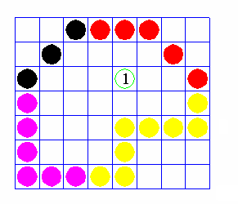
Flood Fill Algorithm
Sometimes we want to fill in (recolor) an area that is not defined within a single color boundary.
We paint such areas by replacing a specified interior color instead of searching for a boundary color value.
This approach is called a flood-fill algorithm.

Slide 63
Flood Fill Algorithm
We start from a specified interior pixel (x, y) and reassign all pixel values that are currently set to a given interior color with the desired fill color.
If the area has more than one interior color, we can first reassign pixel values so that all interior pixels have the same color.
Using either 4-connected or 8-connected approach, we then step through pixel positions until all interior pixels have been repainted.

